Slide 1
Go-Chat
1570348 Park, Woo Min
1604674 Li, Yiqi
1655556 Chen, Wenwen
1561297 Chen, Jing
1611211 Chen, Huiping
1669396 Muawwanah, Anisaul

Slide 2
Outline
Introduction
Project Description
Aims and Strategy
Time table
Initial Progress
Project Organization

Slide 3



Introduction
Server
Web Client
Windows client

Slide 4
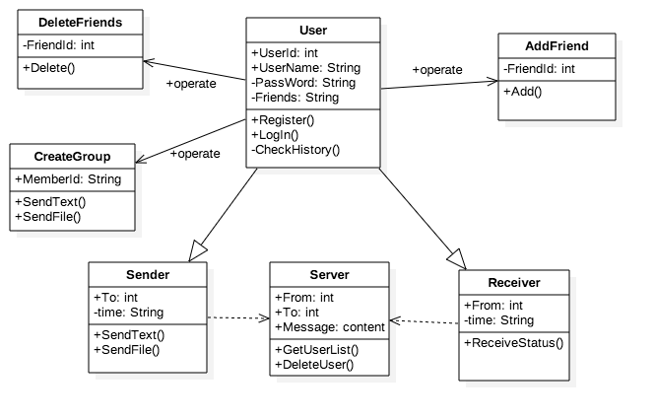
Project Structure
<UML Class Diagram>

Slide 5
Aims and Strategy: Level 1
Sever
Database :MYSQL
Web server :apache
Client
Web :PHP
Window application :C#

Slide 6
Aims and Strategy: Level 1
Add some…………………………
Client1
Server
Client2
2. Send message
1. Send message
3. Send request
4. Send data

Slide 7
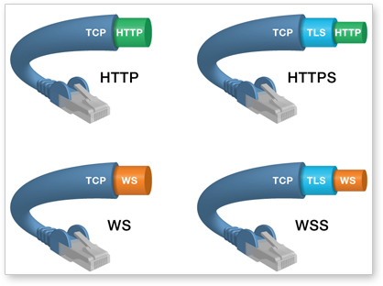
Aims and Strategy: Level 2
<Web socket over TLS>

Slide 8

Aims and Strategy: Level 2
<Database security>

Slide 9







Aims and Strategy: Level 3

Slide 10
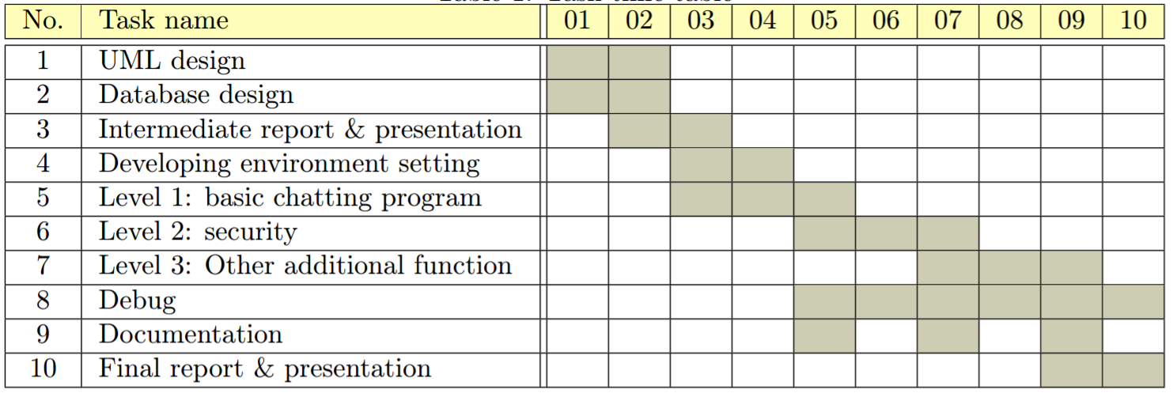
Time table

Slide 11
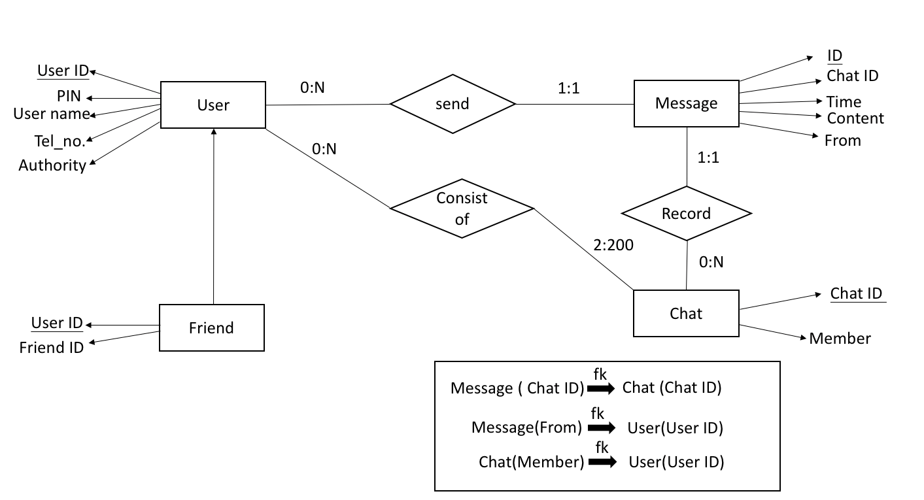
Initial Progress
<ER model>

Slide 12
Initial Progress
<UML Class Diagram>

Slide 13
Project Organization
To collaborate with each other
Weekly meeting :Guy’s campus library
Whatsapp
Github
LaTex :overleaf

Slide 14
Project Organization
Peer Assessment
Conflict Handling
Discuss possible solutions
Choose the best solution (advantages & disadvantages)
Mark | Woomin | Yiqi | Wenwen | Jing | Huiping | Anisaul | Total
Basic | 15 | 15 | 15 | 15 | 15 | 15 | 90
Performance | n₁ | n₂ | n₃ | n₄ | n₅ | n₆ | Σn=10
Total |  |  |  |  |  |  | 100

